Slide 1
Enhanced Entity-Relationship Modelling
Connolly and Begg, Ch 12

Slide 2
Introduction
Why EER
  Limitations of basic concepts of the ER model
  requirements to represent more complex applications using additional data modeling concepts.
Hence additional data modelling concepts
  specialization/generalization
  aggregation
  composition.

Slide 3
Introduction
Deeper understanding of entity structure
A diagrammatic techniques for displaying
  specialization/generalization,
  Aggregation
  composition
using UML.

Slide 4
The Enhanced Entity-Relationship Model
Semantic concepts are incorporated into the original ER model and called the Enhanced Entity-Relationship (EER) model.
Common additional concepts are:
  specialization / generalization
  aggregation
  composition.

Slide 5
Specialization / Generalization
Superclass
  An entity type that includes one or more distinct subgroupings of its occurrences.
Subclass
  A distinct subgrouping of occurrences of an entity type.
Super/Sub class
  Student: Undergrad, Postgrad
  Citizen: Leader, elder, ...

Slide 6
Specialization / Generalization
Superclass/subclass relationship is one-to-one (1:1).
Superclass may contain overlapping or distinct subclasses.
Not all members of a superclass need be a member of a subclass.

Slide 7
Specialization / Generalization
Attribute Inheritance
  An entity in a subclass represents same ‘real world’ object as in superclass, and may possess subclass-specific attributes, as well as those associated with the superclass.
The subclass of undergrad has attribute like internshipPlace unique to it, grad student has Thesis title, but both have common attributes like name, gender.

Slide 8
Specialization / Generalization
Specialization
  Process of maximizing differences between members of an entity by identifying their distinguishing characteristics.
Generalization
  Process of minimizing differences between entities by identifying their common characteristics.

Slide 9
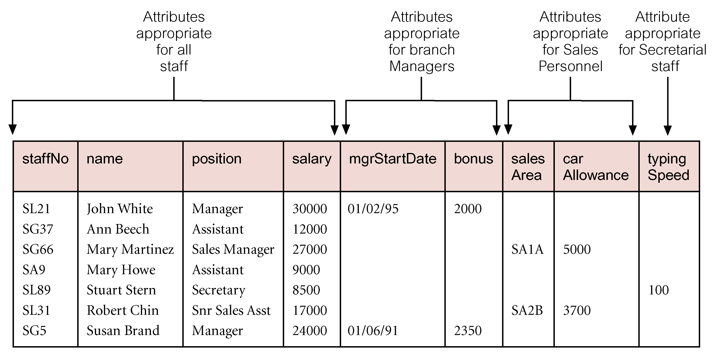
AllStaff relation holding details of all staff

Slide 10
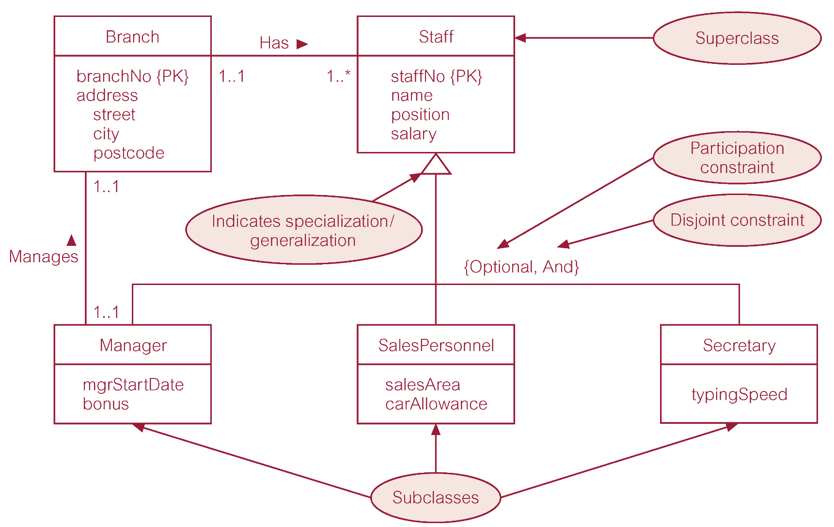
Specialization/generalization of Staff entity into subclasses representing job roles

Slide 11
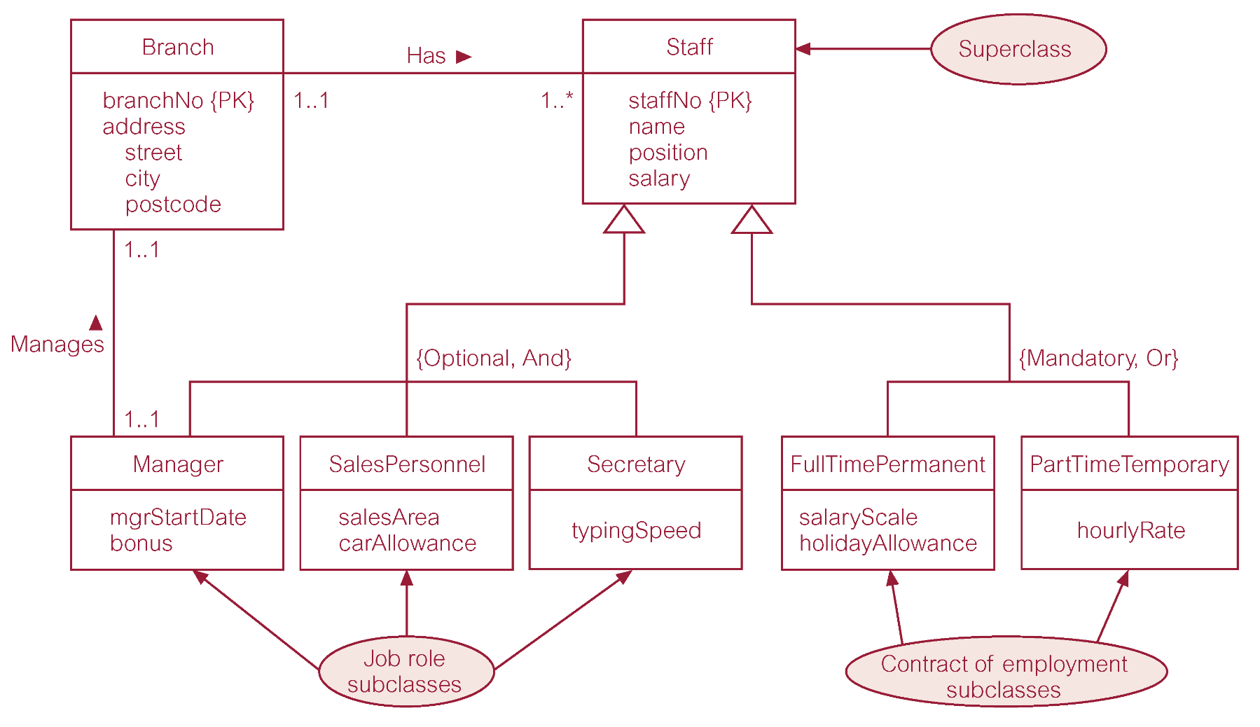
Specialization/generalization of Staff entity into job roles and contracts of employment

Slide 12
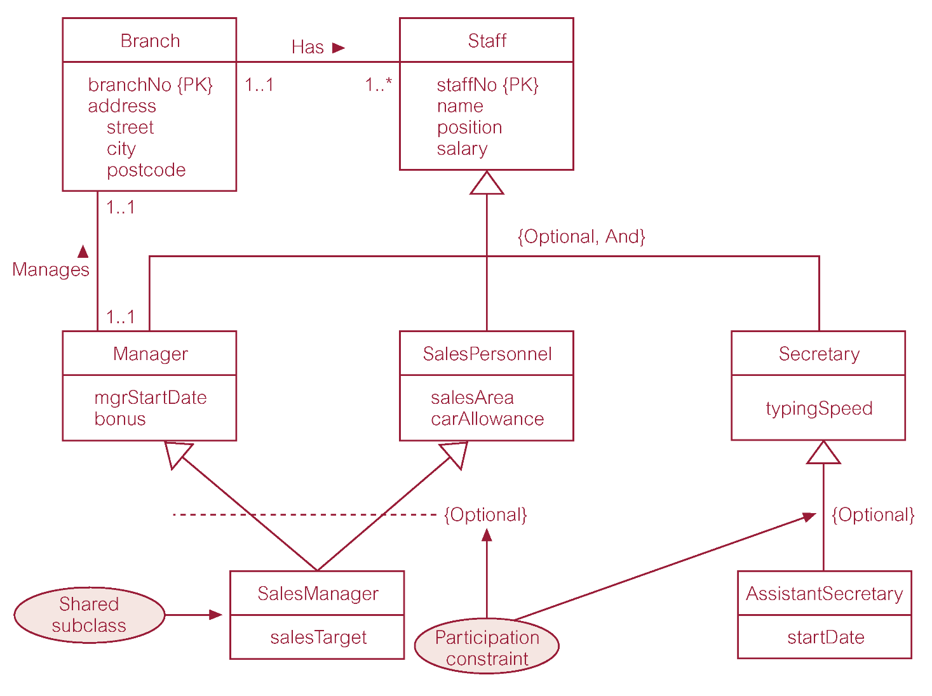
EER diagram with shared subclass and subclass with its own subclass

Slide 13
Constraints on Specialization / Generalization
Two constraints that may apply to a specialization/generalization:
  participation constraints
  disjoint constraints.
Participation constraint
  Determines whether every member in superclass must participate as a member of a subclass.
  May be mandatory or optional.

Slide 14
Constraints on Specialization / Generalization
Disjoint constraint
  Describes relationship between members of the subclasses and indicates whether member of a superclass can be a member of one, or more than one, subclass.
  May be disjoint or nondisjoint.
  Represented as and /or

Slide 15
Constraints on Specialization / Generalization
There are four categories of constraints of specialization and generalization:
  mandatory and disjoint
  optional and disjoint
  mandatory and nondisjoint
  optional and nondisjoint.

Slide 16
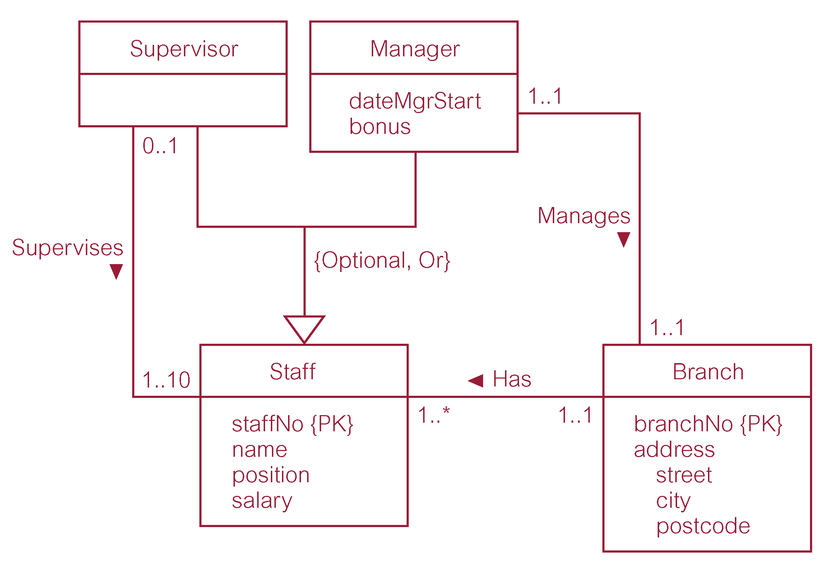
Example: Staff Superclass with Supervisor and Manager subclasses

Slide 17
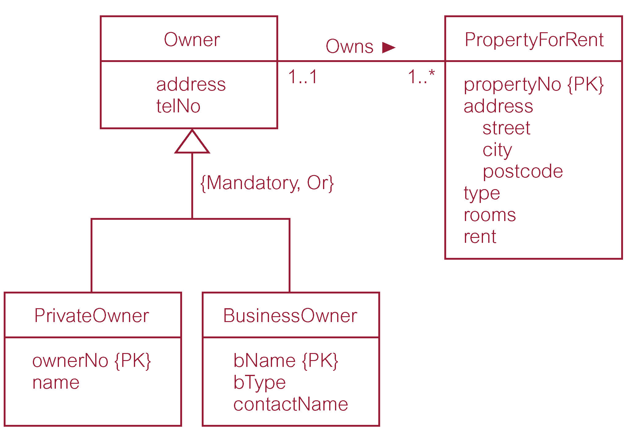
Example - Owner Superclass with PrivateOwner and BusinessOwner subclasses

Slide 18
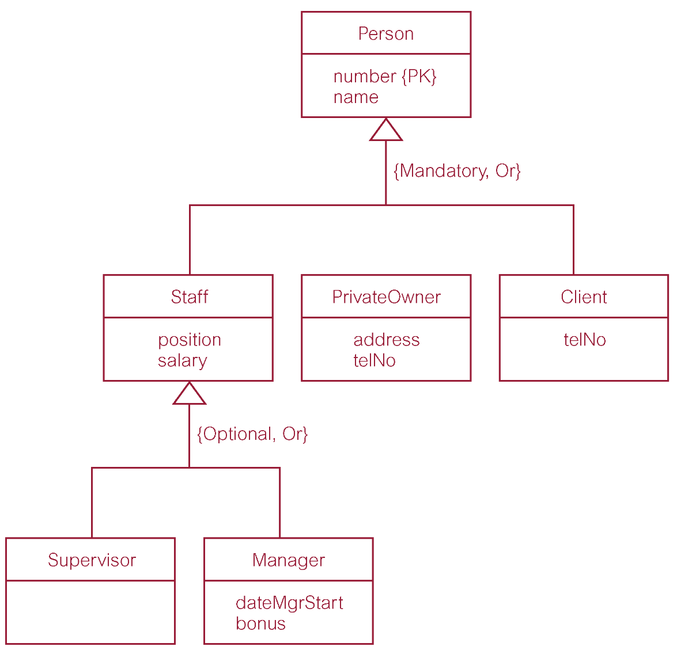
Example - Person superclass with Staff, PrivateOwner, and Client subclasses

Slide 19
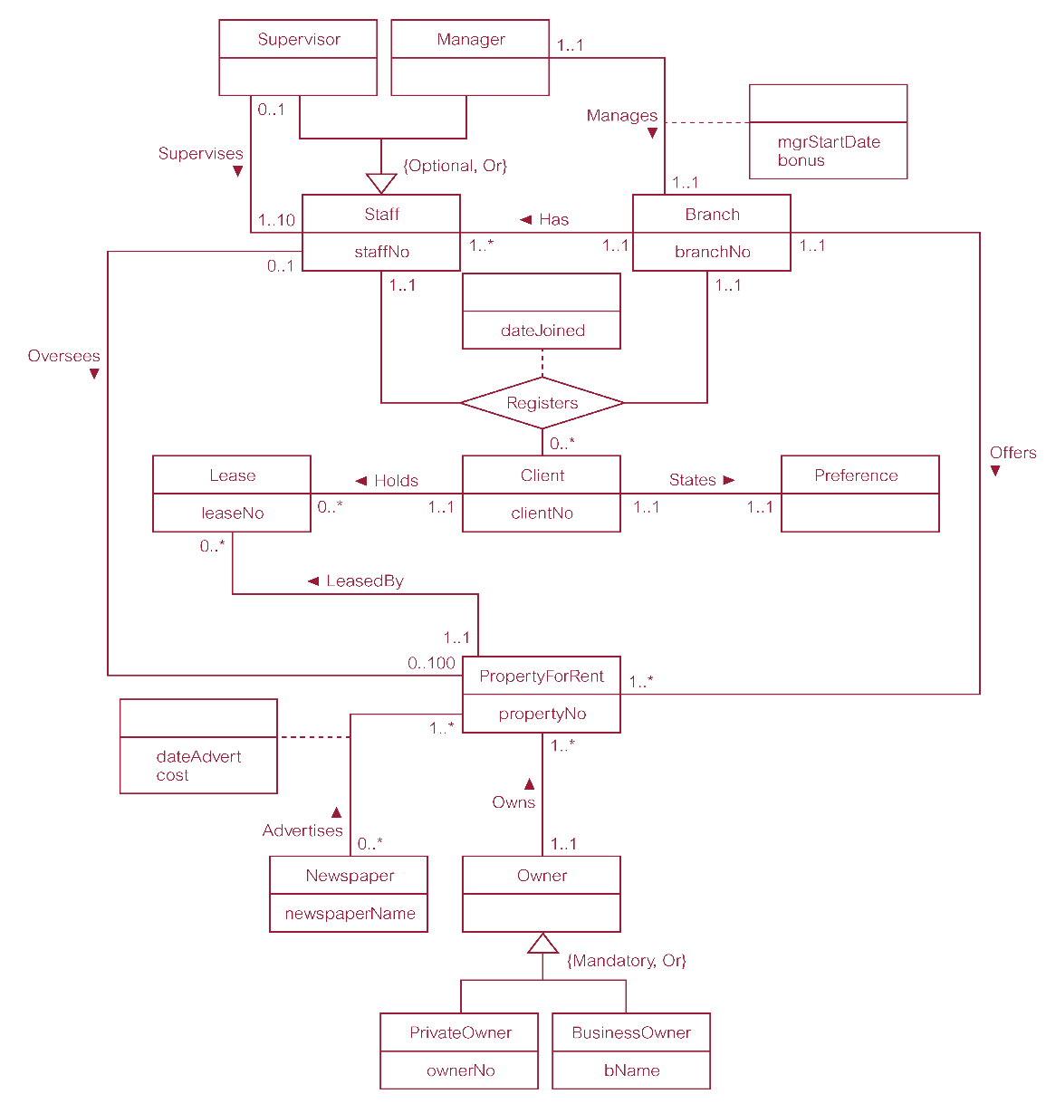
Amalgamated

Slide 20
Read about
Aggregation
Composition

Slide 21
Note
The multiplicities will change when an entity is enhanced.
  What is optional may become mandatory
Mapping in the enhanced case is also enhanced
  Especially when mapping aggregated and specialized entities

Slide 22
Mapping in EER
Relationships
  Mapped like in ER
  But the associated relations change since they are generated from enhanced entities

Slide 23
Mapping in EER
Depends on the nature of specialization /generalization
Specifically
  Optional – And
  Optional – Or
  Mandatory – And
  Mandatory – Or

Slide 24
Mapping in EER
Optional – And
  Have a relation for the parent
  Have a relation parent and children Joined
Optional – OR
  Have a relation for the parent
  Have a relation for parent and each child

Slide 25
Mapping in EER
Mandatory or
  Have a relation for each of the children
Mandatory – And
  Collapse the whole entity into one relation

